Slide 1
Network Architectures
A simplified view …

Slide 2
Disclaimer
The purpose of this session is NOT to make you network engineers
We will look briefly at networks, structures of networks and a little bit at protocols
The goal is mainly to give you an overview, with enough understanding to comprehend how it affects architecture and design

Slide 3
The story so far …
We have looked at
  Computers
  Operating Systems
  Applications
  IPC (on the same computer)
Data transfer before 1970s
  Sneakernet
  2016 – Amazon hard drive truck
After 1970
  At first – need share files (ARPANET)
  Evolved into
    remote access
    application communications
  And so, networks were born …

Slide 4
History (condensed)
1961 – idea of ARPANET (paper “Information Flow in Large Communication Nets”)
  idea of packet switching -> modern internet
1966 – ARPANET development started
1969 – ARPANET is launched (first 2 nodes)
1969 – first RFC RFC 1: Host Software
1969 – “pre-router”
1970 – NetWare Core Protocol is created
  file sharing / access, printing, auth, etc
1971 – first email is sent
1973 – Ethernet is developed
1976 / 1978 – first routers are created

Slide 5
History (condensed)
1978 – TCP/IP
1981 – IPv4 – RFC 791
1983 – ARPANET works on TCP/IP
1983 – DNS is created
1988 – WaveLAN (precursor to Wi-Fi)
1988 – firewall idea
1990 – first switch
1996 – IPv6 (still not there)
1997 – 802.11 (modern Wi-Fi, up to 2 Mbps)

Slide 6
History (condensed)
1999 – WEP (Wi-Fi encryption)
2003 – 802.11g (up to 20 Mbps)
2009 – 802.11n (5 GHz)
2011 – 4G LTE => smartphone boom
2014 – HTTP/2 (shared connections, non-blocking requests)
2015 – Wi-Fi 5 (Gbps)
2020 – 5G (low latency (to 1ms) => IoT, autonomous vehicles, AR/VR)
2020 – HTTP/3 (always encrypted, better on unstable networks)
2021 – Wi-Fi 6 (dense environments – airports, stadiums)
2024 – Wi-Fi 7 (40+ Gbps, AR/VR, 8k streaming, metaverse)

Slide 7
Networking terms
Domain Name System (DNS):
  translates Internet addresses to IP addresses (nslookup rit.edu)
  => know what computer to reach
  DNS-servers
    13 root servers
      store referrals for top-level domains
      for .edu ask this server
    TLD (top-level domain) servers
      knows which domain belongs to which authoritative server
    Authoritative servers
      own domains
    Recursive resolvers
      local ISPs, Google 8.8.8.8, Cloudflare 1.1.1.1
      cache & ask
  update delays (a lot is cached) => cannot switch instantly => some traffic flows to old servers

Slide 8
Networking terms
Dynamic Host Configuration Protocol (DHCP):
  automatically assigns IP addresses to the devices on a network
  from a pre-configure range of allowable IP addresses
  avoid conflicts for self-appointed IPs
  computer joins a network
  computer sends a broadcast 255.255.255.255:67 – who is a DCHP server here?
    255.255.255.255 – to every computer in the network
  DHCP server replies with an available IP-address
  computer confirms

Slide 9
Networking terms
Ethernet:
  set of networking standards for wired networks
  there are alternatives:
    fiber-optic links
    power line communications (via electrical network)
    coaxial cables
    Etc
  most used
  faster than Wi-Fi
  more reliable than Wi-Fi
  cables ☹

Slide 10
Networking terms
Virtual Private Network (VPN):
  creates a secure channel between 2 networks
  networks think they are the same
  outsiders do not see what’s in the channel
  encrypted
  usage:
    connectivity across branches
    ATM to bank
    personal privacy / security in public networks
    regional restrictions (mask the output point)
    censorship avoidance
    torrents
  not anonymous!!!
    private VPN-servers hold logs (almost all of them)
    don’t use for piracy, of course

Slide 11
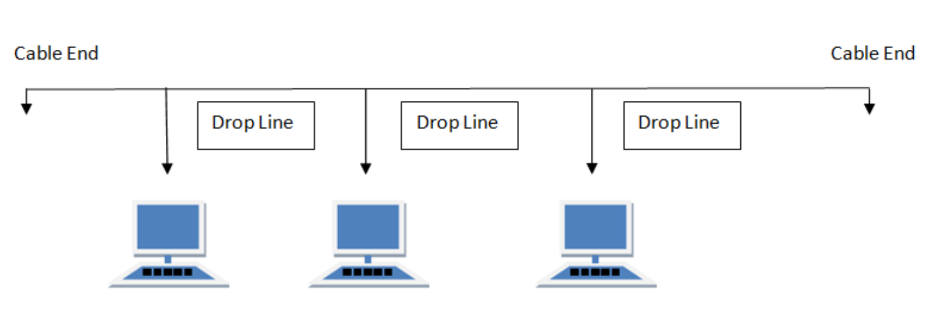
Networking Architecture terms
Topology – physical network layout
  Impact – performance, reliability, cost
  Currently – many are hybrid
Bus - common backbone to connect all devices (like a hardware bus). Signals in both directions
  pros:
    simple & cheap
  cons:
    1 failure => network is gone
    collisions
      2 devices transmit towards each other
      signal interference
      impossible to decode
  usage:
    early Ethernet
https://www.lifewire.com/computer-network-topology-817884

Slide 12
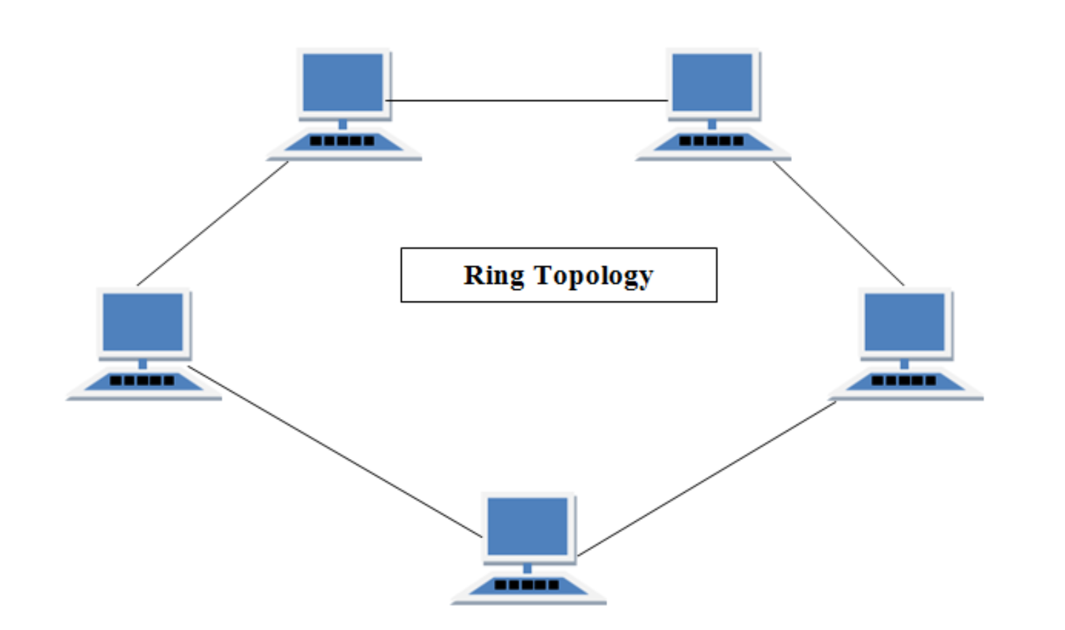
Networking Architecture terms
Topology – physical network layout
  Impact – performance, reliability, cost
Ring - Messages travel through a ring in the same direction
  pros:
    simple & cheap
    no collisions (same direction signals)
  cons:
    1 failure => network is gone
  usage:
    some organizations in 80s-90s
    dual rings for fault tolerance
https://www.lifewire.com/computer-network-topology-817884

Slide 13
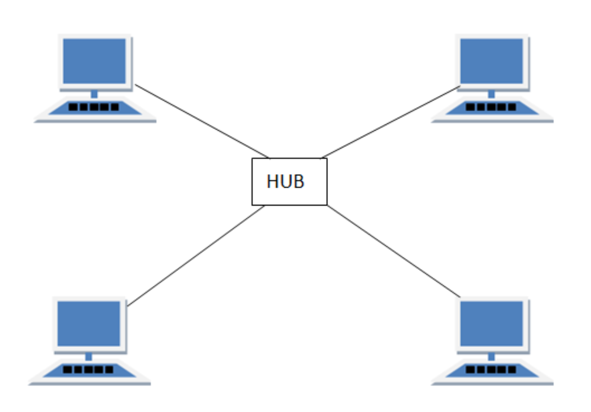
Networking Architecture terms
Topology – physical network layout
  Impact – performance, reliability, cost
Star – devices connected to a central hub / switch / router
  pros:
    easy to add / remove devices
    isolated failures
  cons:
    single point of failure
    not scalable
  usage:
    home networks & small offices
    wi-fi / LAN routers
https://www.lifewire.com/computer-network-topology-817884

Slide 14
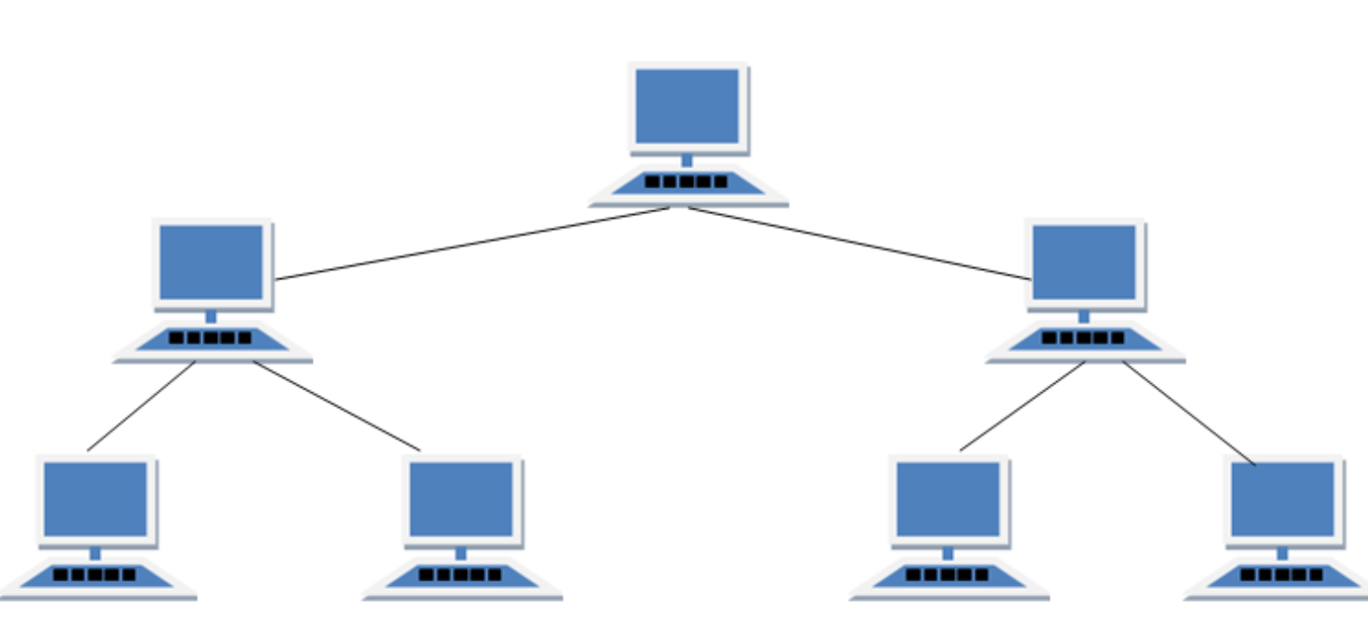
Networking Architecture terms
Topology – physical network layout
  Impact – performance, reliability, cost
Tree – multiple ‘Star’ networks connected to a bus
  pros:
    scalable & manageable
    failure isolation
    hierarchical management
  cons:
    single point of failure
    complex
  usage:
    large organizations
    e.g., campus – each building is a cluster (connected by a bus)
https://www.lifewire.com/computer-network-topology-817884

Slide 15
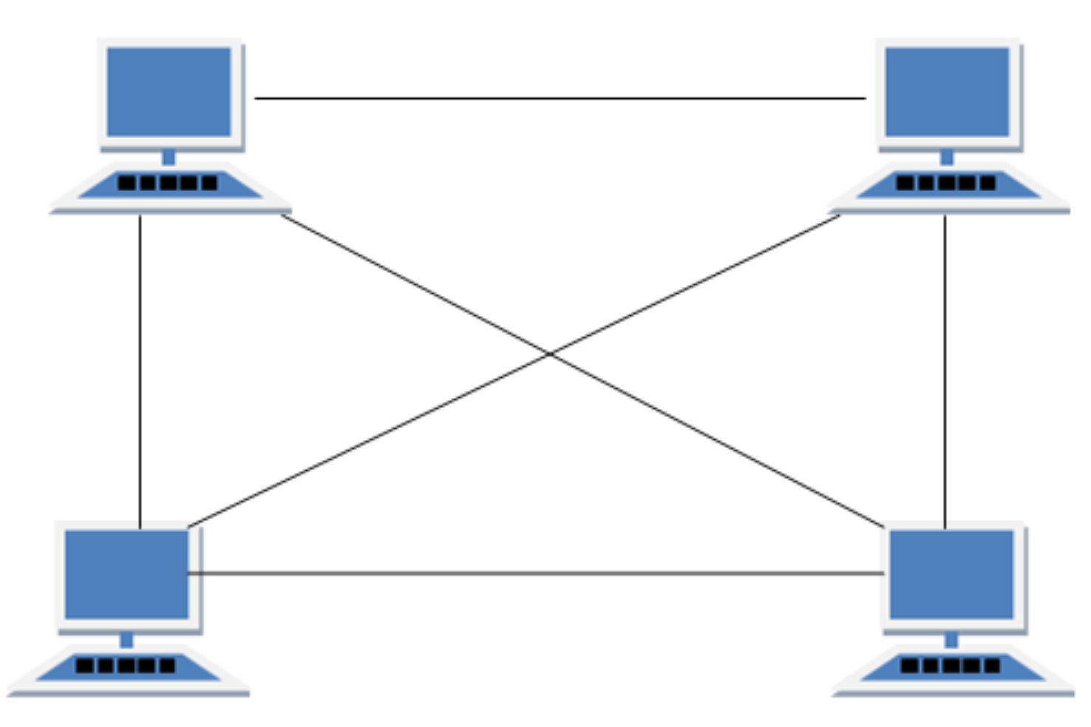
Networking Architecture terms
Topology – physical network layout
  Impact – performance, reliability, cost
Mesh – interconnections, multiple routes from source to destination
  each to each – full mesh
  each to some – partial mesh
  pros:
    highly reliable
  cons:
    expensive
    complex (~n^2 connections)
    hard to maintain
  usage:
    datacenters
    ISPs
    military & emergency networks
https://www.lifewire.com/computer-network-topology-817884

Slide 16
OSI model
Open System Interconnection – networking framework
  networking is complex
    different devices
    a lot of software & embedded
  OSI – gives a structure
  Building a house
    foundation
    walls
    wiring
    plumbing
    etc
    do not intermix
https://en.wikipedia.org/wiki/OSI_model

Slide 17
OSI model
Layers
  1 – Physical
    data carrier
    e.g., Ethernet cable, Wi-Fi signal
  2 – Data link
    data transfer between devices in the same network
    breaks packages into frames
    e.g., switch, network card
  3 – Network
    data routing
    breaks data into packages
    e.g., IPv4, IPv6
  4 – Transport
    provides reliability & order OR fast delivery
    split data into “larger packages” (segments for TCP, datagrams for UDP)
    e.g., TCP, UDP
https://en.wikipedia.org/wiki/OSI_model

Slide 18
OSI model
Layers
  5 – Sessions
    manages sessions, ensures communication continuity
    e.g., login to a server, keep a session alive
  6 – Presentation
    translate data into transferable format
      compression
      encryption
      encoding
    e.g., HTTPS encrypts traffic with TLS, Unicode -> ASCII for URL
  7 – Application
    provides networking to applications
    e.g., HTTP, FTP, POP3, DNS
Protocols – communication rules
Low level
  TCP/IP, Token Ring (levels 2-4)
High level
  FTP, HTTP, etc (Level 7)
User application is not a layer!!!
FileZilla (FTP client) is not a layer
FileZilla uses FTP (protocol)
FTP (as a protocol) is on Layer 7
APIs build on top of Layer 7
https://en.wikipedia.org/wiki/OSI_model

Slide 19
OSI model example
Browser opens rit.edu
  Resolve the domain -> IP address => DNS – Layer 7
  TLS handshake & data encryption => TSL – Layer 6
  Connection / session with RIT server is established => Layer 5
  Data is split into packets that are numerated & sent => TCP – Layer 4
  Packets routed from the source IP to the target IP => IP – Layer 3
    & split into IP packets
  Network device split packets into frames => Data link – Layer 2
    & uses devices MAC addresses
  Bits move though physical cables => cables – Layer 1
  On the target side – opposite process
    Bytes => frames => packets => data => decryption => handling

Slide 20
Protocols aid in API creation
Protocols – rules of communications
  format should be followed
  content doesn’t matter
  JSON object – properly organized set of bits
  properly organized - contract
  level higher – bytes becoming texts (e.g., text commands)
  texts should follow some rules
  again a contract
In a way – every layer has an API
Traditionally speaking – API on top of all layers

Slide 21
Impact on Software architecture
Distribution of components
  Each ‘network hop’ adds to delays
    network layout is important
  Communications delays (network protocols)
    shift between layers takes time (packet split / recovery)
    TCP vs UDP
  Processing delays (logic and data transformation per component)
    e.g., encryption / decryption overhead
  Firewalls
    take time
    can block something
    but security
  Network segmentation
    add security
    but add hops & complexity
Distributed systems
Scalability vs performance

Slide 22
Impact on Software architecture
Management of components
  Have zero control over remote components
  How are failures managed?
    retry?
    fail fast?
    circuit breakers?
    fallback?
    chaos monkey – reliability should be engineered, not assumed

Slide 23
Impact on Software architecture
API management
  What is exposed / hidden?
  What about versioning?
    Request to which version?
    Transition / witch?
    Logic coexistence?
  Auth?
  etc
Protocols?
  Which one?
    HTTP (simplicity & readability)
    gRPC (performance)
    SOAP (strictness)
    etc
  Encryption?
  etc

Slide 24
Simple Network applications
(almost) Earliest network applications - Email & FTP
Let’s see how they work …
We’re going to go ‘bare metal’ and use telnet
- A simple text-based utility running on top of TCP
- ‘Teletype Network’

Slide 25
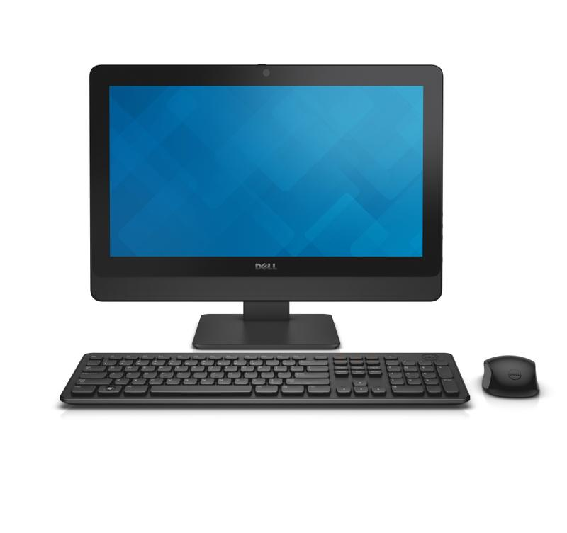


Email -- Send
Sending an email relies on the SMTP (Simple Mail Transfer Protocol)
  multiple steps inside
When you click ‘Send’
Message is wrapped in the SMTP format
  e.g., headers - sender, recipient
Message is encoded and send to your local SMTP server
Recipient domain is extracted
DNS server is located to find the receiving domain
Message is send to the domain
Domain Server locates the receiving SMTP server
Email is stored on the receiving SMTP server
kalrabb@rit.edu
SMTP Server
DNS
kalrabb@rit.edu
Domain Server
Receiving SMTP Server
Pull email: POP or IMAP

Slide 26
Protocols: Text based
Basically, open a port, send commands
> telnet
> open mymailserver.smtp.com 25 //the port
> EHLO mydomain.com
> MAIL FROM: kalrabb@mydomain.com
> RCPT TO: sendto@theirdomain.net
> DATA <….>
https://docs.microsoft.com/en-us/Exchange/mail-flow/test-smtp-with-telnet?view=exchserver-2019
EHLO vs HELO: Indicates level of RC support (EHLO is newer)
The sender; errors will return to this email address
Recipient(s); can be issued multiple times
Mail content, including header fields
Subject:
- To:
- cc:
<CRLF> to end headers
‘.’ to end data
RFC 5321 - Simple Mail Transfer Protocol (ietf.org)

Slide 27
With RIT server
RITs mail relay for SMTP is smtp-server.rit.edu
Can use HELO or EHLO
Need to be within RIT network when using it
Only accepts rit email senders (?)
Different SMTP servers have different rules for sequence of commands, authentication rules and controls around who can use them

Slide 28
With mymail.rit.edu
> telnet mymail.rit.edu 25
HELO
250 ex04mail01a.ad.rit.edu Hello [74.74.135.96]
MAIL TO:
kalrabb@gmail.c501 5.5.4 Unrecognized parameter
om
500 5.3.3 Unrecognized command
MAIL FROM: kalrabb@rit.edu
500 5.3.3 Unrecognized command
RCPT
500 5.3.3 Unrecognized command
MAIL FROM: kalrabb@rit.edu
250 2.1.0 Sender OK
RCPT TO: kalrabb@gmail.com
550 5.7.1 Unable to relay
RCPT TO: <kalrabb@gmail.com>
550 5.7.1 Unable to relay
RCPT TO: kalrabb@rit.edu
250 2.1.5 Recipient OK
DATA
354 Start mail input; end with <CRLF>.<CRLF>
This is test line only
Subject: test subject
.
250 2.6.0 <01d75957e0fc44cfb2aa20c9e154a8a9@ex04mail01a.ad.rit.edu> [InternalId=113528870540153, Hostname=ex04mail01d.ad.rit.edu] Queued mail for delivery
QUIT

Slide 29
Other notes
Email was created with text data in mind
  cat memes didn’t exist anyway
Solution – MIME (Multi-part Internet Mail Extensions)
  allows encoding non-text data (e.g., binary)
  allows multiple items
  email as a container
  => attachments!
  also used for HTTP data transfer
    e.g., Content-Type: image/jpeg <- MIME

Slide 30
Exploring Network Protocols
Assignment:
- Using telnet command line, you will connect to and send email via SMTP (use mymail.rit.edu)
- Using the command line, you will connect to and send a file via FTP (https://docs.microsoft.com/en-us/windows-server/administration/windows-commands/ftp#:~:text=The%20ftp%20command-line%20parameters%20are%20case-sensitive.%20This%20command,sub-environment%20in%20which%20you%20can%20use%20ftp%20commands.)
Using FTP to seappserver3.rit.edu, upload a text file containing your smtp command history for sending an email. Use anonymous login

Slide 31
Background info

Slide 32
Who still uses FTP?
Everyone (almost) … you just can’t see it
Example:
MOVEit – enterprise file transfer software
  2023 – security breach
  web UI – unavailable
  FTP / SFTP - works
The local article
University of Rochester investigating data breach - WHEC.com
The details
MOVEit Transfer customers warned of new flaw as PoC info surfaces (bleepingcomputer.com)

Slide 33
The secrets of RFCs
The third step in the procedure is the DATA command. DATA <CRLF> If accepted, the receiver-SMTP returns a 354 Intermediate reply and considers all succeeding lines to be the message text. When the end of text is received and stored the SMTP-receiver sends a 250 OK reply. Since the mail data is sent on the transmission channel the end of the mail data must be indicated so that the command and reply dialog can be resumed. SMTP indicates the end of the mail data by sending a line containing only a period. A transparency procedure is used to prevent this from interfering with the user's text (see Section 4.5.2). Please note that the mail data includes the memo header items such as Date, Subject, To, Cc, From [2].
https://www.rfc-editor.org/rfc/rfc821#page-19
This specification permits multiple occurrences of most fields. Except as noted, their interpretation is not specified here, and their use is discouraged. The following syntax for the bodies of various fields should be thought of as describing each field body as a single long string (or line). The "Lexical Analysis of Message" section on "Long Header Fields", above, indicates how such long strings can be represented on more than one line in the actual transmitted message. message = fields *( CRLF *text ) ; Everything after ; first null line ; is message body
https://www.rfc-editor.org/rfc/rfc822#section-4.1

